Slide 1
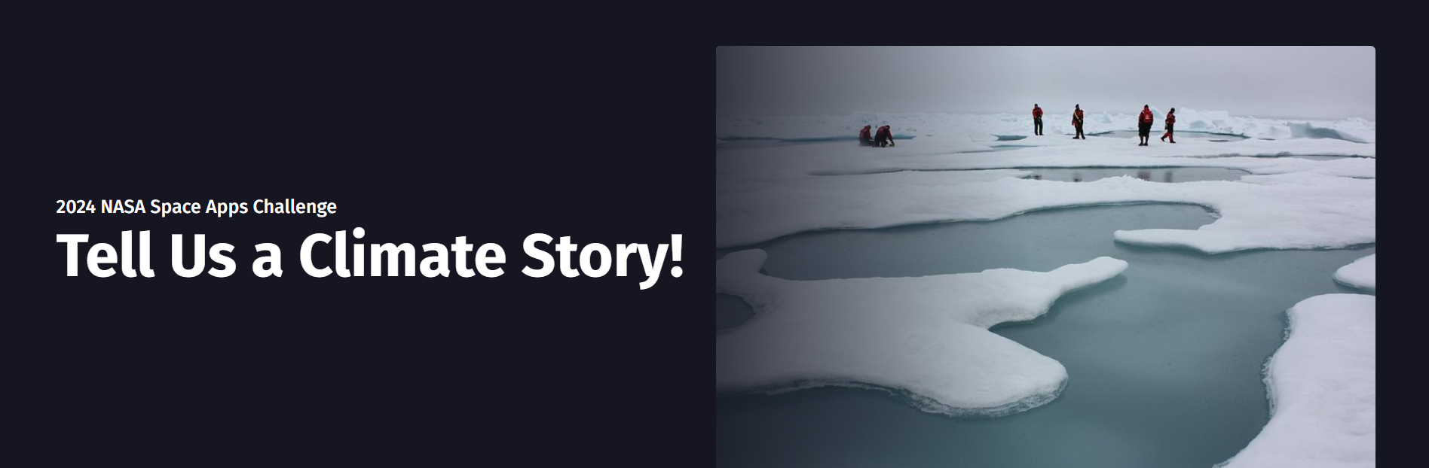
Team: AstroHacks
Shalvin Shabu
A.V Dhananjay
Ronald K.S
Sanjay P.J
Ajith Vargese T.H
Vishnu Mohan P

Slide 2

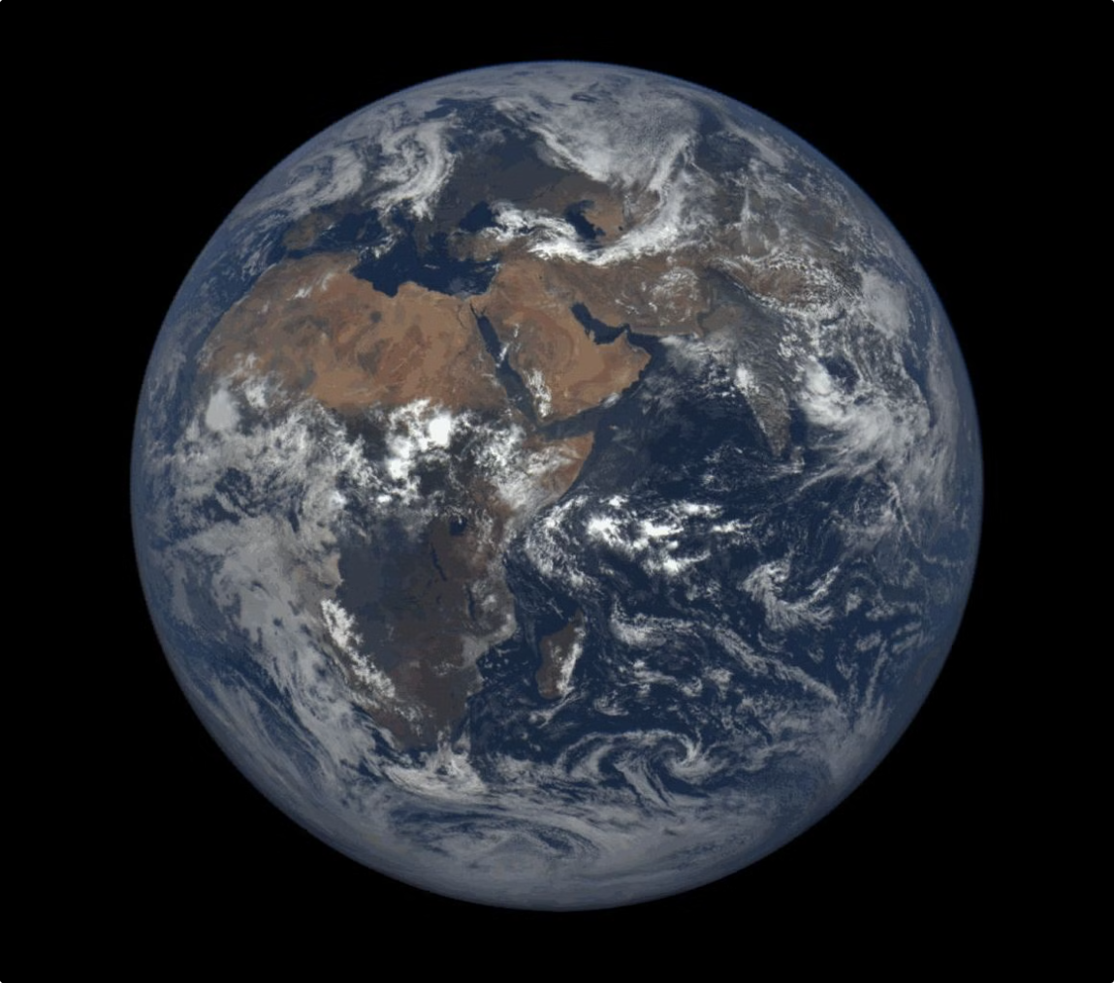
The Rising Cost of Climate Change: How Greenhouse Gas Emissions Fuel Extreme Weather
Climate change is a complex issue with far-reaching consequences. Global warming, driven by the buildup of greenhouse gases, is altering weather patterns around the world, leading to more frequent and severe extreme weather events.

Slide 3

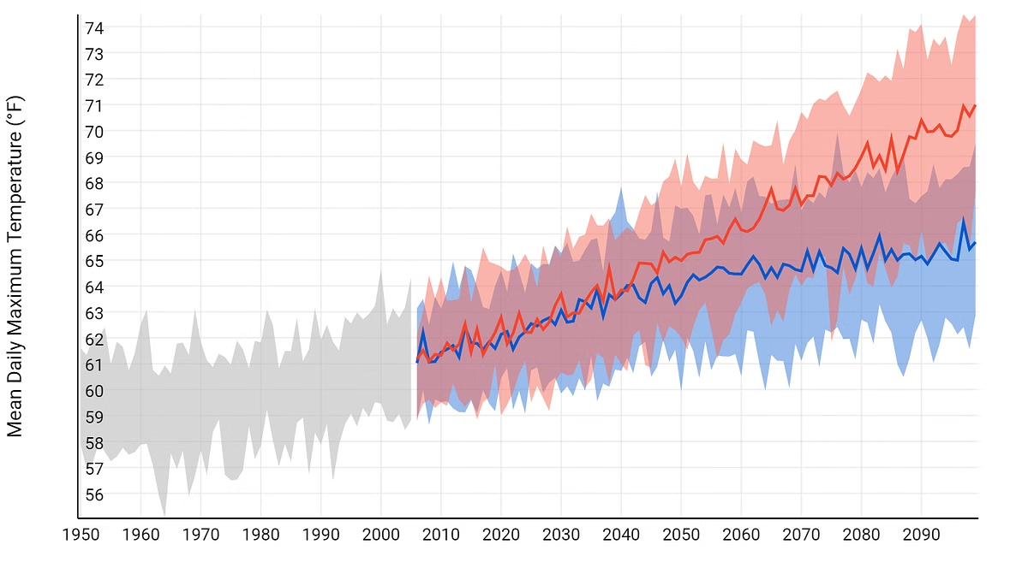
Introduction: The Alarming Trend of Global Temperature Rise
1
Rising Temperatures
2
Human Influence
The global average temperature has increased by about 1 degree Celsius since the late 19th century, with most of the warming occurring in the last 40 years.
Human activities, primarily the burning of fossil fuels, have released large amounts of greenhouse gases into the atmosphere, trapping heat and driving global warming.
3
Unprecedented Change
The rate of warming is unprecedented in Earth's history, with significant impacts on natural systems and human societies.
AstroHacks

Slide 4


The Science Behind Global Warming: Greenhouse Gases and the Greenhouse Effect
Greenhouse Effect
Greenhouse Gases
The natural greenhouse effect is essential for life on Earth, regulating temperatures and allowing for a habitable climate.
Greenhouse gases, such as carbon dioxide, methane, and nitrous oxide, trap heat in the atmosphere, preventing it from escaping into space.
Human-Induced Enhancement
Human activities have significantly increased the concentration of greenhouse gases in the atmosphere, enhancing the greenhouse effect and causing global warming.

Slide 5
Extreme Weather Events: Hurricanes, Floods, Droughts, and Wildfires
Hurricanes
Floods
Droughts
Warmer ocean temperatures provide more energy for hurricanes, intensifying their strength and increasing the risk of catastrophic damage.
Higher temperatures lead to increased evaporation and precipitation, resulting in more frequent and severe flooding events.
Climate change can alter rainfall patterns, leading to prolonged periods of drought, impacting agriculture, water resources, and ecosystems.
AstroHacks

Slide 6

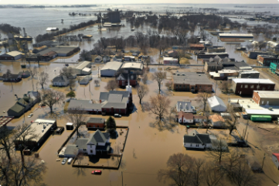
The Escalating Costs of Extreme Weather: Economic Impacts and Human Toll
Economic Losses
Health Impacts
Extreme weather events cause billions of dollars in damage to infrastructure, property, and businesses, impacting economies worldwide.
Extreme heat, floods, and droughts can lead to heatstroke, waterborne diseases, and malnutrition, posing significant threats to human health.
1
2
3
Human Displacement
Extreme weather events can force people to evacuate their homes, leading to displacement and disruption to livelihoods and communities.
AstroHacks

Slide 7

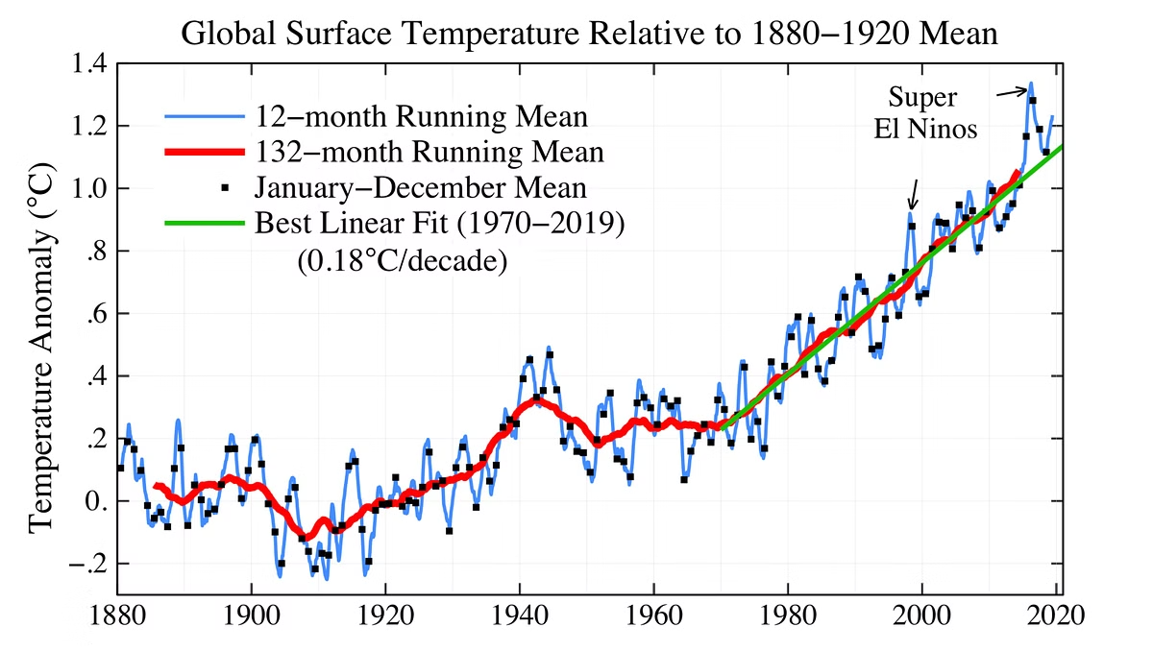
Analyzing the Data: Correlations Between Emissions and Extreme Weather
Greenhouse Gas Emissions
Extreme Weather Events
Increased carbon dioxide concentrations
Higher frequency and intensity of hurricanes
Rising global temperatures
More frequent and severe heat waves
Changes in precipitation patterns
Increased risk of droughts and floods

Slide 8


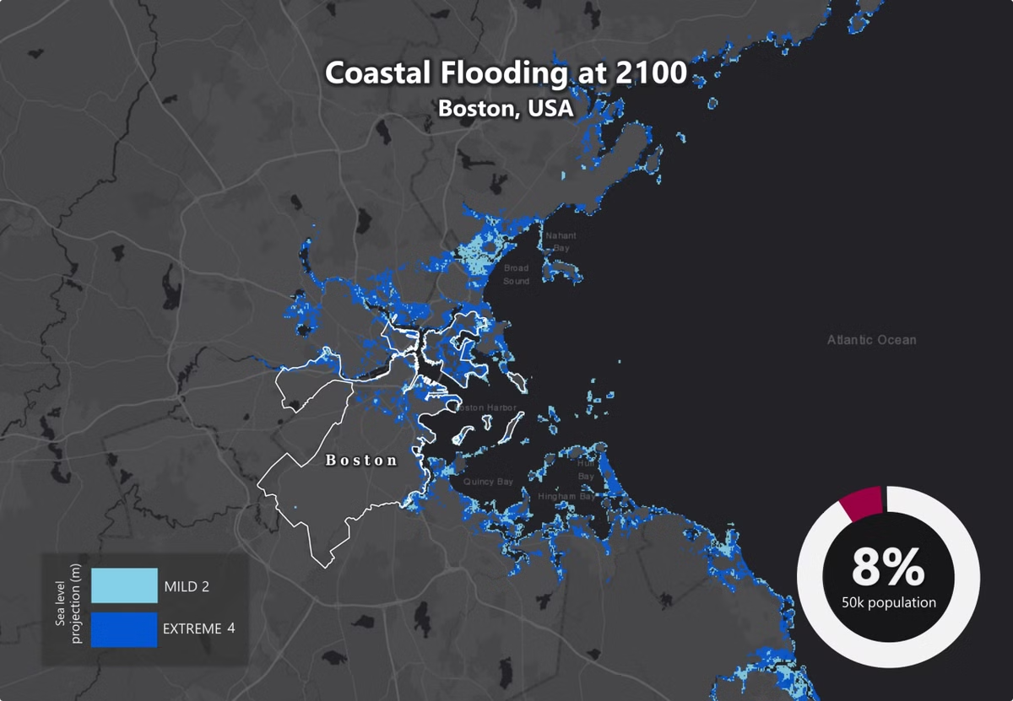


Projections and Forecasts: Future Scenarios and Risks
Continued Warming
If greenhouse gas emissions continue at their current rate, global temperatures are projected to rise by several degrees Celsius by the end of the century.
Increased Risks
This warming will lead to more extreme weather events, sea-level rise, and other impacts that threaten human health and the environment.
Urgent Action
Addressing climate change requires urgent and decisive action to reduce greenhouse gas emissions and adapt to a changing climate.
AstroHacks

Slide 9

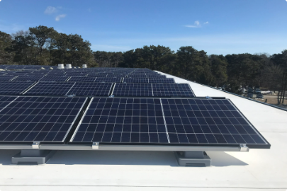




Mitigating the Impacts: Strategies for Reducing Greenhouse Gas Emissions
Renewable Energy
Forest Conservation
Energy Efficiency
Sustainable Practices
Transitioning to renewable energy sources, such as solar and wind power, can significantly reduce greenhouse gas emissions.
Protecting and restoring forests helps absorb carbon dioxide from the atmosphere, mitigating climate change.
Improving energy efficiency in buildings, transportation, and industries can reduce energy consumption and greenhouse gas emissions.
Adopting sustainable practices in agriculture, manufacturing, and consumption can reduce emissions and promote environmental conservation.
AstroHacks

Slide 10
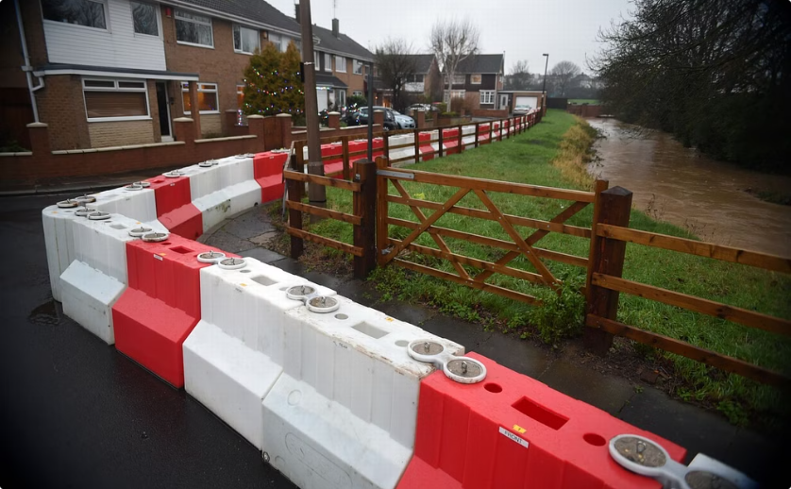
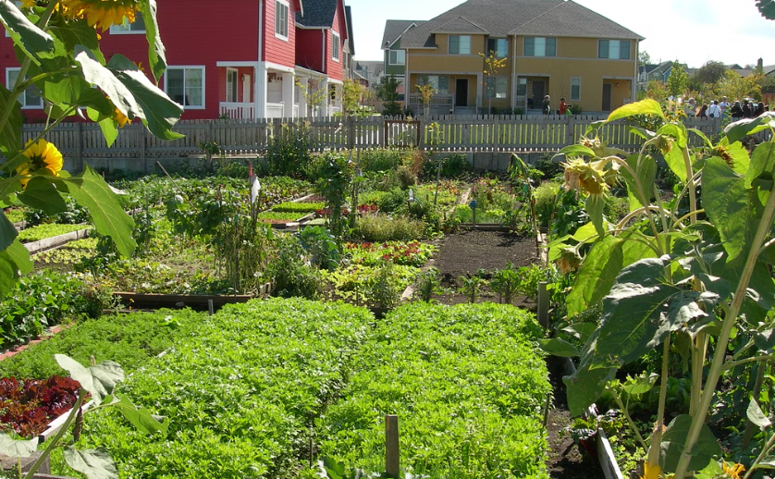
Adapting to a Changing Climate: Building Resilient Communities
Infrastructure Resilience
Community Preparedness
Investing in infrastructure that can withstand extreme weather events, such as sea walls and flood defenses, is crucial for adaptation.
Educating communities about climate change risks and developing emergency response plans can enhance resilience.
AstroHacks

Slide 11


Conclusion: A Call to Action - Combating Climate Change Together
Climate change is a global challenge that requires collective action. By reducing greenhouse gas emissions, investing in adaptation measures, and promoting sustainable practices, we can mitigate the impacts of climate change and create a more resilient future for all.

